Slide 1

SMART PARKING SYSTEM with IBM Watson

Slide 2
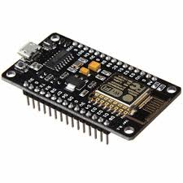
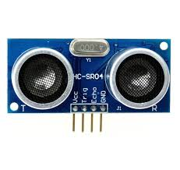
HARDWARE REQIUREMENTS
ESP8266-(NODEMCU DEV 1.0)
Ultrasonic Sensor (HC-SR04)

Slide 3
ESP8266 - NODEMCU 1.0
It is a microcontroller and WiFi Module.
Here ESP stands for espressive, the manufacturer's name.
It has 40 pins on the whole.
In which 13 GPIO pins (General Purpose Input Output pins) are present on it.
These pins are used to connect the external devices to the microcontroller

Slide 4
ULTRASONIC SENSOR
It uses sonar to detect the distance.
It can be used in object sensing.
It can calculate values in the range of 2cm - 400cm (1feet to 13feet)
It's operating voltage is 5V.

Slide 5
WORKING PRINCIPLE
ULTRASONIC
SENSOR
NODEMCU
IBM CLOUD
MOBILE APP

Slide 6
WORKING PRINCIPLE
Once the sensor is connected to NodeMCU, the sensor emits a sonar wave for 10 micro seconds.
This is done at the trigger pin.
Then trigger pin goes to low state.
The echo pin waits to receive the echo after hitting the obstacle.
In our case, the obstacle is a car.
If the distance sensed is minimum, then it means the slot is not available for parking and viceversa.

Slide 7
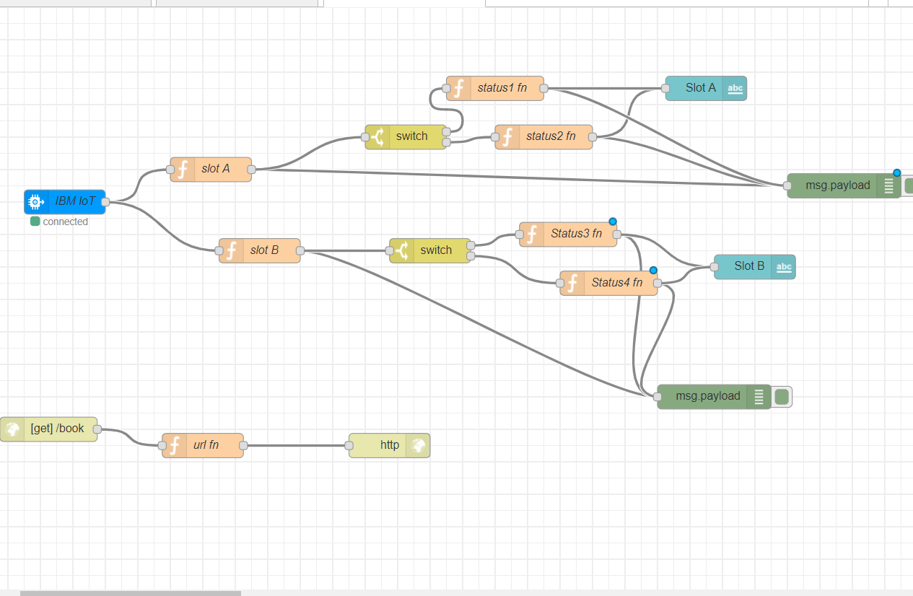
NODE RED FLOW EDITOR

Slide 8
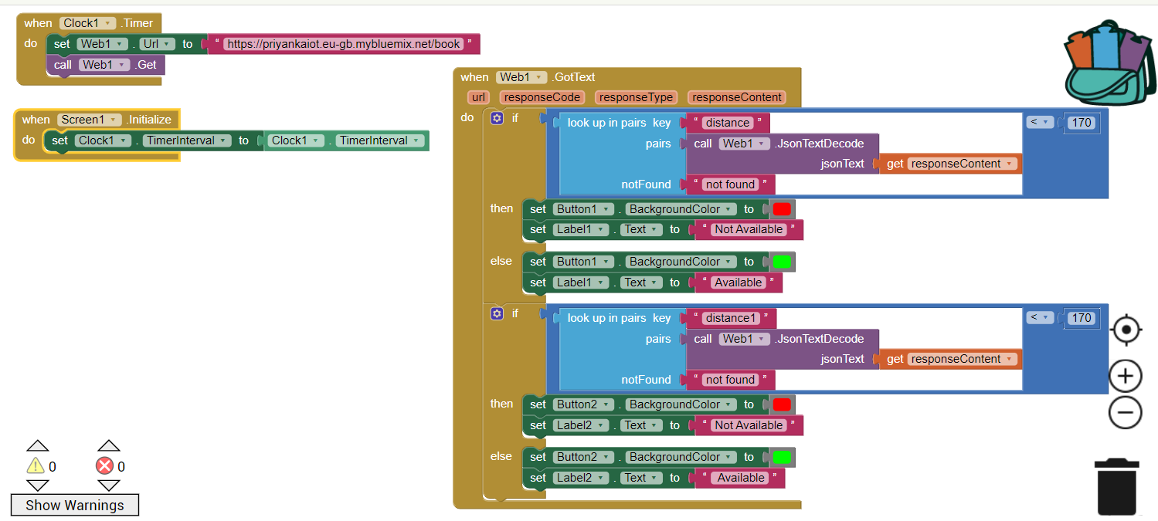
MIT MOBILE APPLICATION

Slide 9
